Slide 1
Integrated Payroll and Accounting System
Chandan Prasad, ADFM / Chakradharpur, SER
Notes:
Session is 90 minutes. Structure first, then switch to the IPAS application itself for the walkthroughs. Tell them a handout follows, so they need not copy screens down.

Slide 2
About IPAS
IPAS
The Integrated Payroll and Accounting System — a web-based application developed by CRIS that runs the payroll and the accounts of every unit of Indian Railways. It is the engine: bills, salary, books, budget, pension.
AIMS
The Accounting Information Management System — the portal through which IPAS is reached, and the institutional brand for the Accounts Department's whole application family. It is the front door.
Notes:
Two minutes. The distinction matters because trainees will hear both names used interchangeably in the office. AIMS is the front door, IPAS is what is behind it.

Slide 3
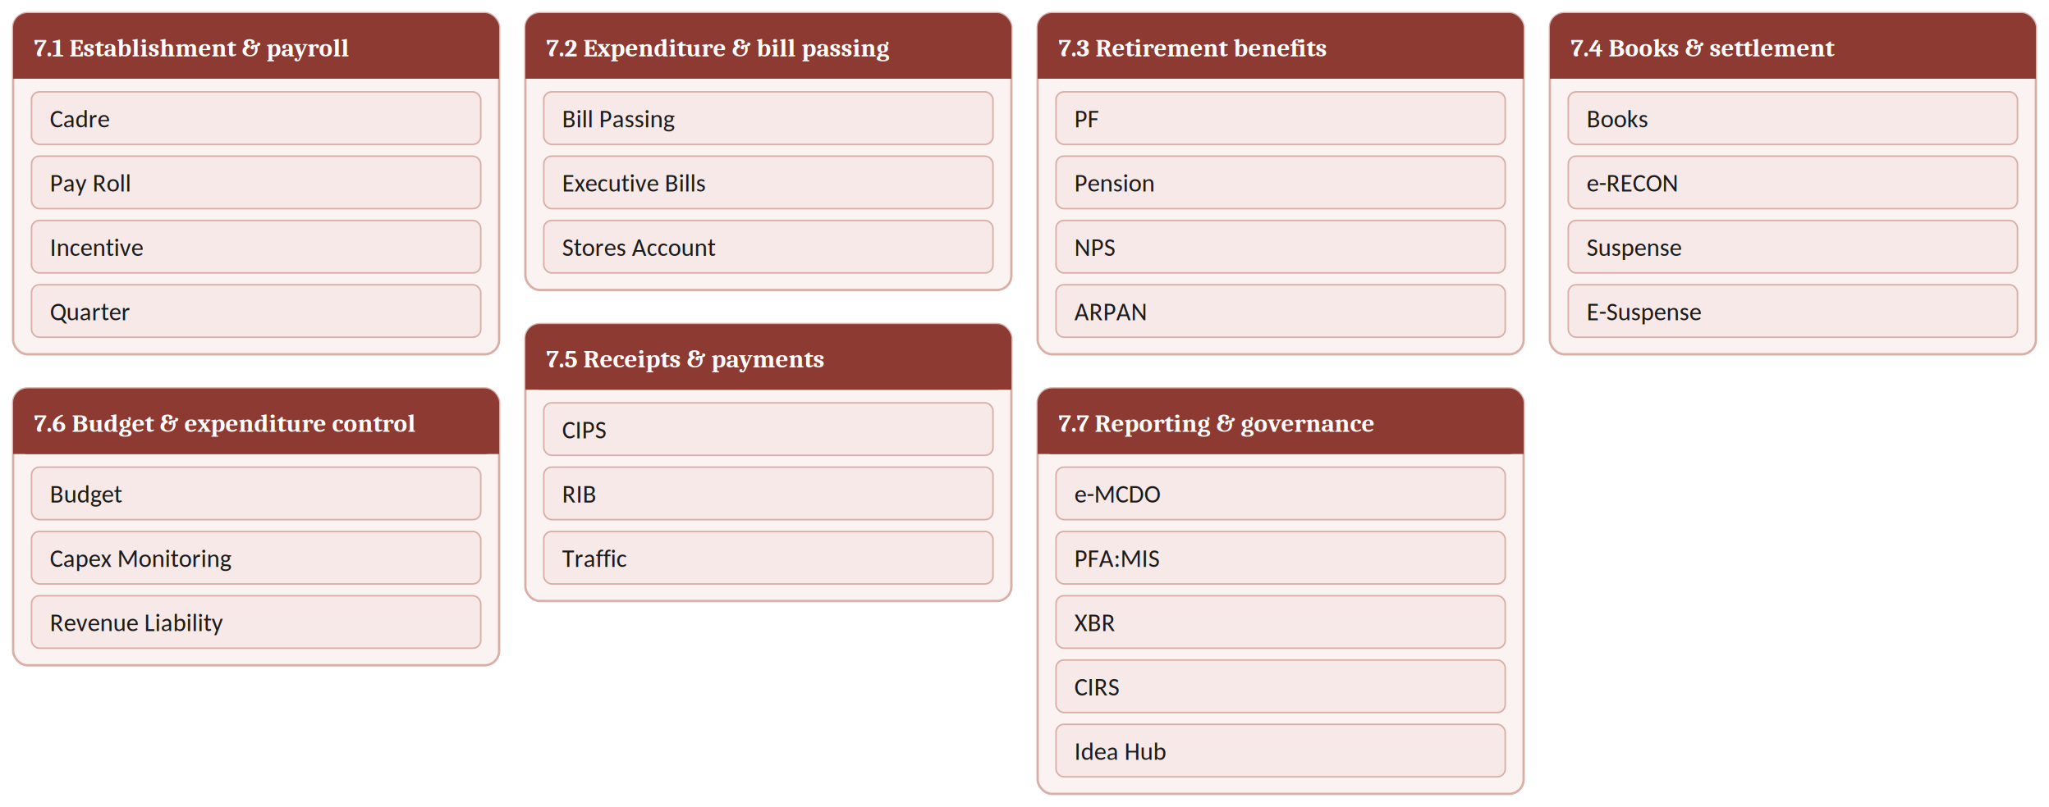
IPAS modules
Notes:
Do not read the modules out. Fifteen seconds to look, then three points: the groupings are functional not official; they will personally touch perhaps six of these in their first posting; the reporting group is what their PFA sees.

Slide 4
Architecture and design
Three-tier, web-based
Single application, single database
Java front end, Oracle back end, browser only. Not tied to any operating system or hardware vendor — a deliberate move away from the Oracle Forms technology of PRIME and AFRES.
PRIME and AFRES were merged and redundant tables dropped. A business rule is changed once and takes effect across Indian Railways simultaneously.
Centralised hosting
Organisational data model
Runs at the CRIS Data Centre, servers clustered in fail-over mode, daily backups. Replaced decentralised processing at zonal IT centres.
Every transaction is anchored to Zonal Railway → Accounting Unit → Bill Unit. An employee carries both a parent and a working unit, so posting and payment can diverge.
Notes:
Three minutes. Dwell on the single-database point — ask what it means for a Board circular changing an allowance rate. CRIS changes it once and every division is compliant the same night. Under PRIME each zone patched its own copy, which is why allowances diverged.

Slide 5
Bill Passing — online sources
Stores bills
Works contracts
Service contracts
Pushed to IPAS from IREPS by the vendor or supplier. Once the CRN is generated in UDM for non-stock items, or the R-Note in iMMS for stock items, the bill is pushed and verified against the purchase order.
Pushed by the executive from IR-WCMS. Payment is made on the basis of the measurement book.
Bills from service contracts are pushed by the executive from IR-WCMS, and arrive for registration in IPAS.
GeM bills
EMD bills
Establishment bills
Pushed by the executive from the Government e-Marketplace.
Earnest money deposit refunds originate in IREPS and arrive for registration against the linked JV and SBI scroll credit.
PF and Pension settlement bills come from HRMS. Salary is prepared in IPAS itself, and is expected to move to HRMS in future.
Notes:
Emphasise the UDM/iMMS split, a common point of confusion: CRN for non-stock, R-Note for stock, PO verification either way. On establishment bills — PF and pension settlement bills arrive from HRMS; salary is prepared inside IPAS and is expected to shift to HRMS in future.

Slide 6
Bill Passing — offline sources
Imprest bills
Quotation bills
Medical bills
Recoupment of station and office imprest.
Purchases made against quotation rather than a formal purchase order.
Reimbursement of medical expenditure.
Law office bills
Entertainment bills
Miscellaneous
Legal fees and associated charges.
Official entertainment expenditure.
Laptop and equipment reimbursement, and other one-off claims.
Notes:
Registered directly in Accounts, section-wise, with no external feed. Ask the class which carries the highest risk — steer to imprest and miscellaneous: small amounts, high volume, no external document trail. Every check the online routes get from integration must here be applied by the officer.

Slide 7
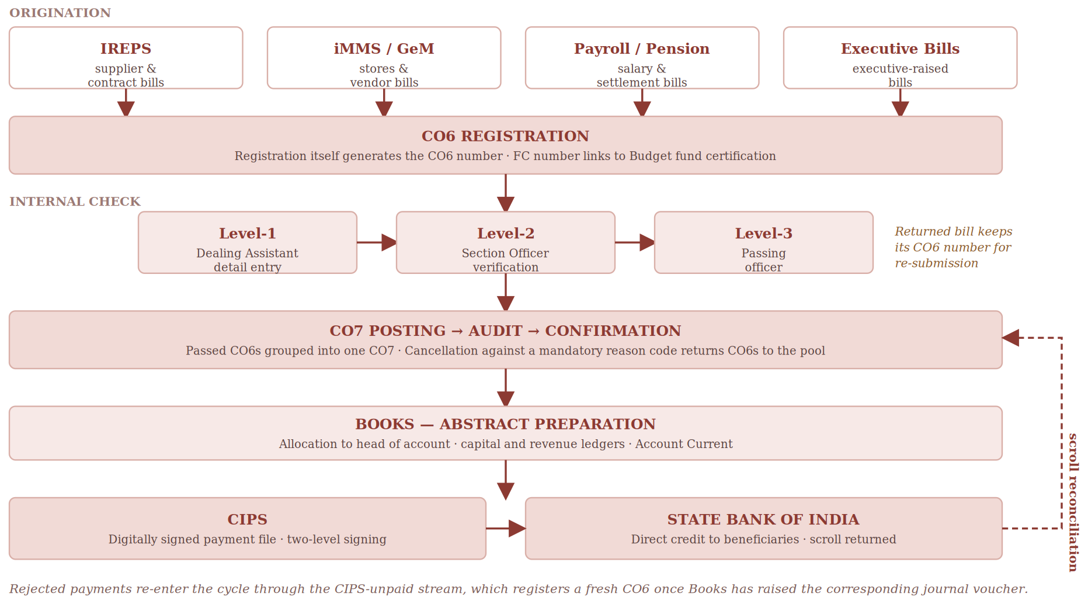
Bill Passing — settlement lifecycle
Notes:
The detailed version; the handout carries it. Walk it once, left to right, in under two minutes. Point at the dashed line: the scroll comes back from the bank and reconciles against the CO7. The loop closing is what makes the payment final.

Slide 8
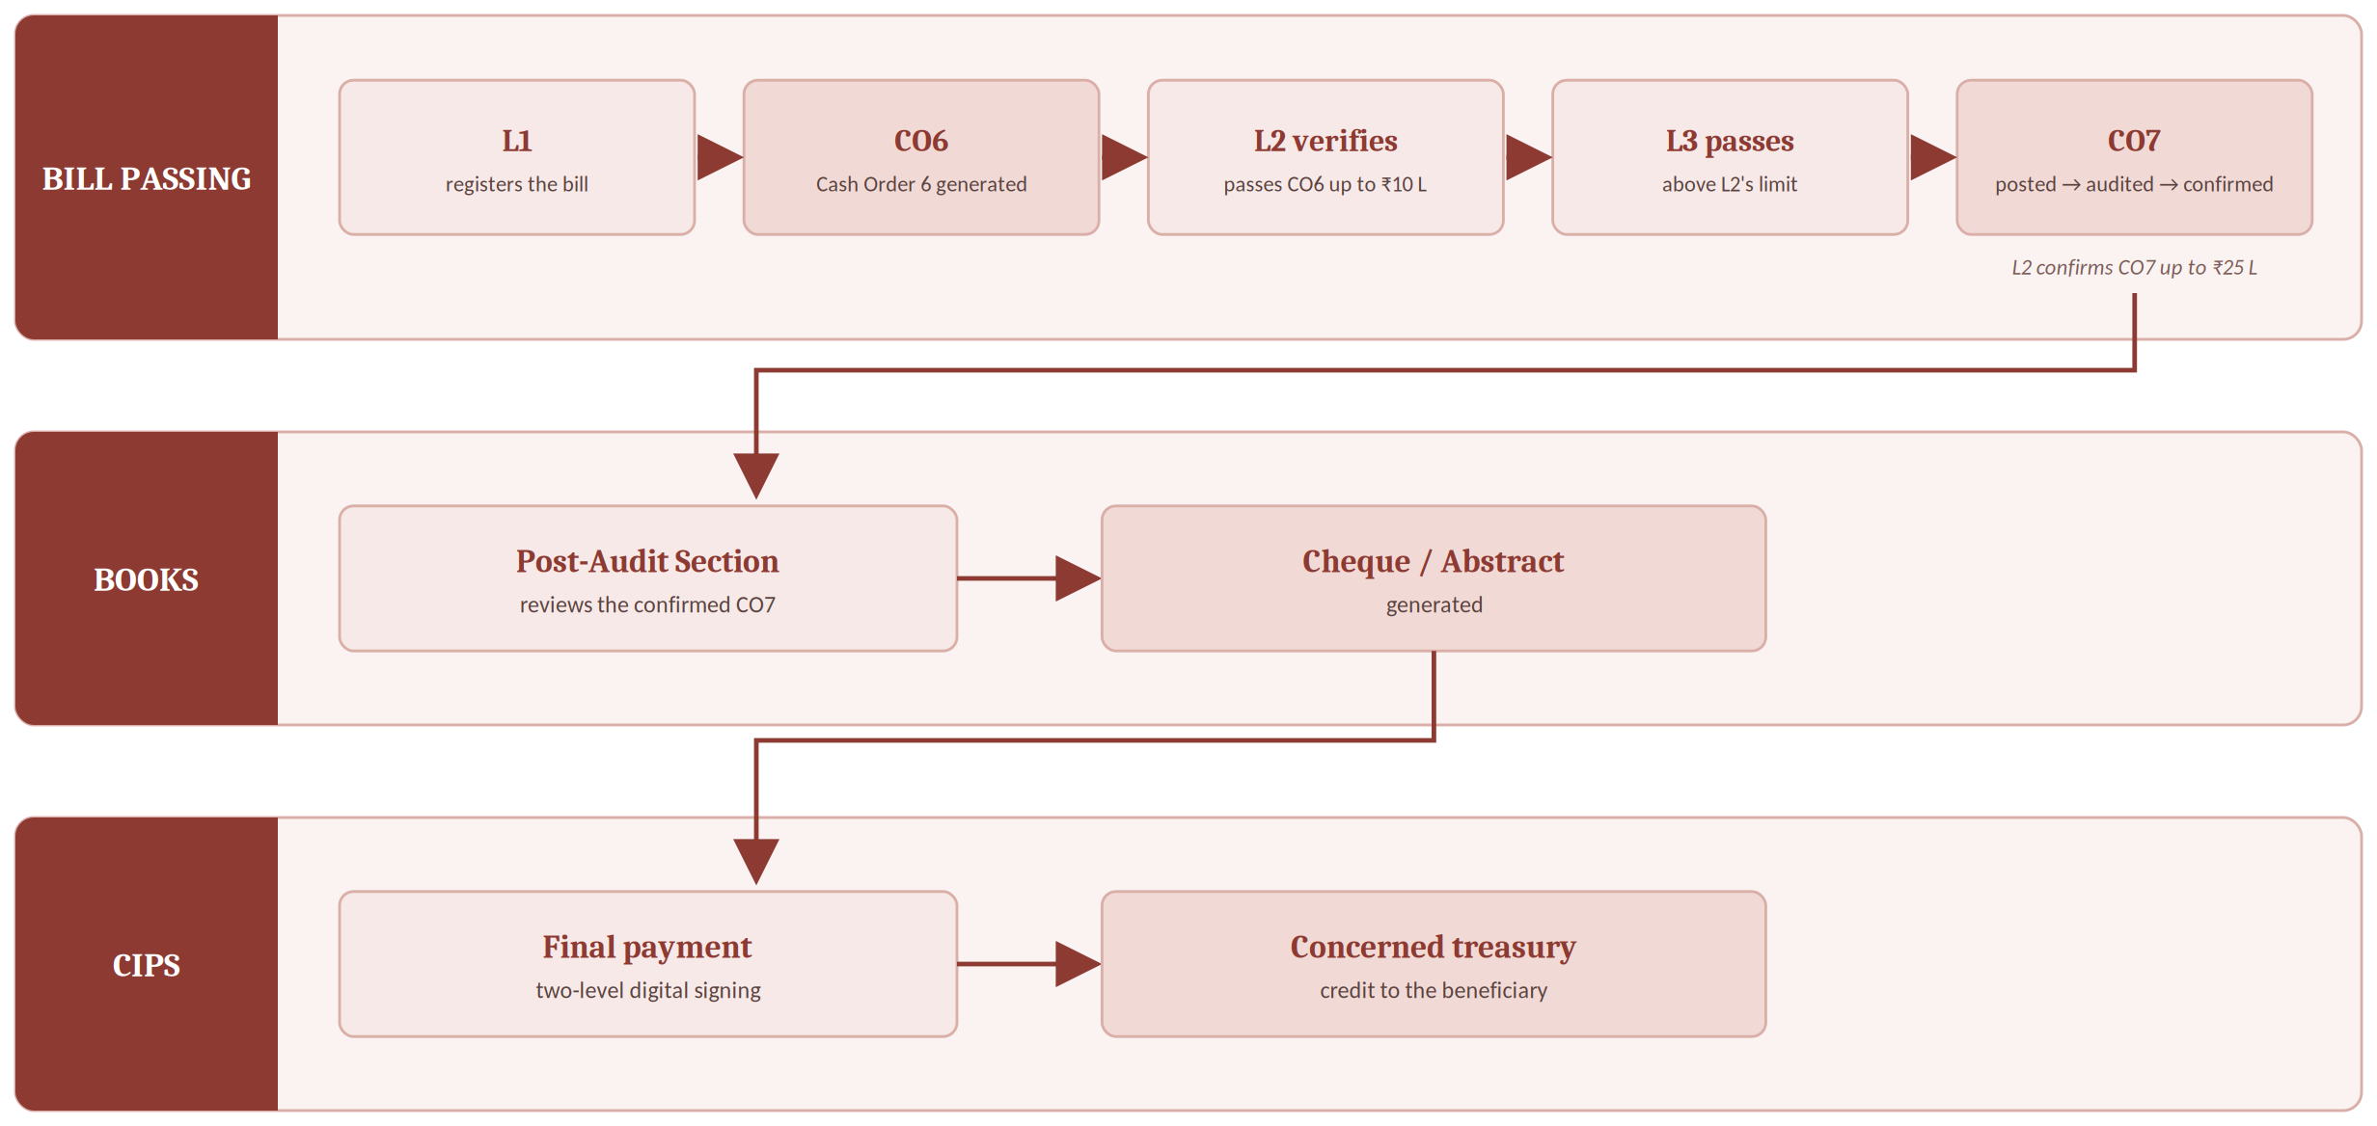
Bill Passing — who does what
Notes:
The version to memorise. Three sections touch every bill: Bill Passing, Books, CIPS. Stress the value gates — L2 passes a CO6 up to ten lakh and confirms a CO7 up to twenty-five lakh; above that it goes to L3. Post-Audit Section here is the old name of the Books Section.

Slide 9
Bill Passing — verification
Invoice and GST
HSN code · amount · taxable amount · GST rate and amount · ITC flagging · GSTN · invoice · bill value · GSTR-2A · payment conditions · statutory deductions
Recoveries — contractors
Budget and allocation
Security deposit · income tax · TDS · labour welfare cess · liquidated damages · works · labour
Budget availability is verified · expenditure is booked to the correct head of account
Notes:
The framing that matters: the first block is what you check on the face of the invoice, the second is what you must deduct before paying, the third is what makes the expenditure legitimate. A bill can be arithmetically perfect and still wrong on every one of these.

Slide 10
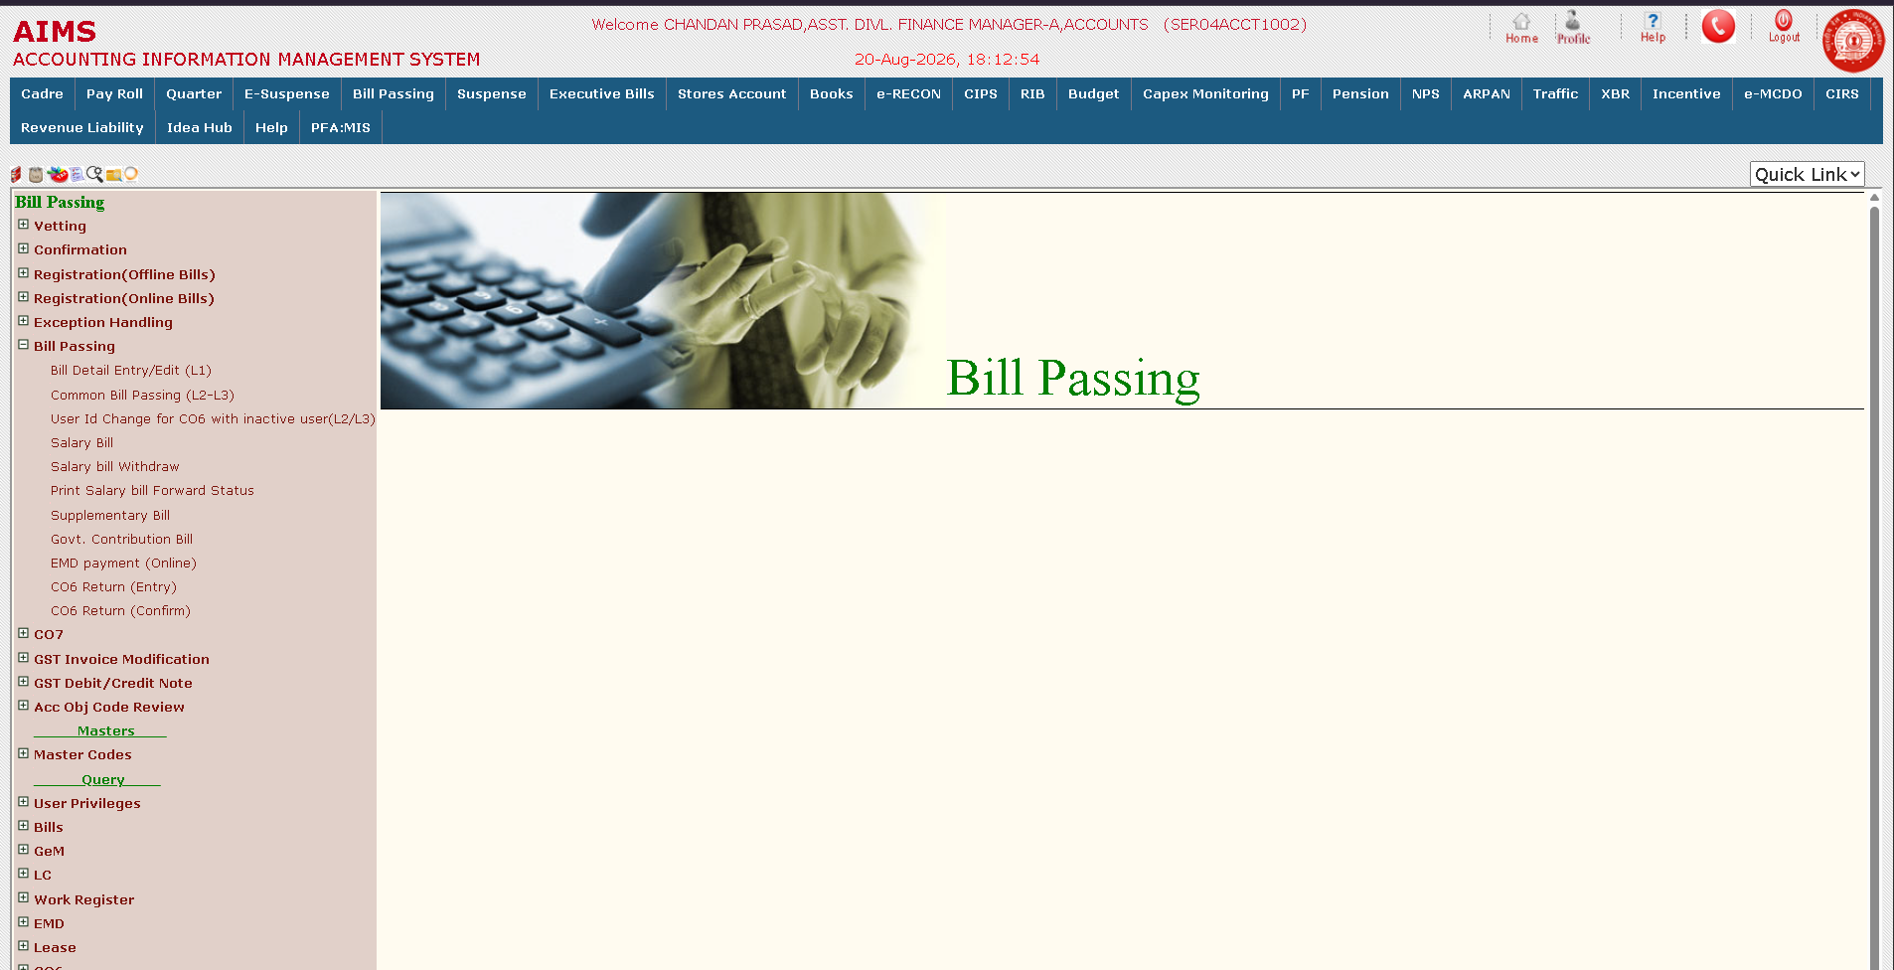
Bill Passing example — the menu
Notes:
Start here. Point out the four registration routes at the top — offline, online, vetting, confirmation — and then Bill Passing itself, where Bill Detail Entry sits at L1 and Common Bill Passing at L2-L3. CO6 Return, entry and confirm, is how a bill goes back.

Slide 11
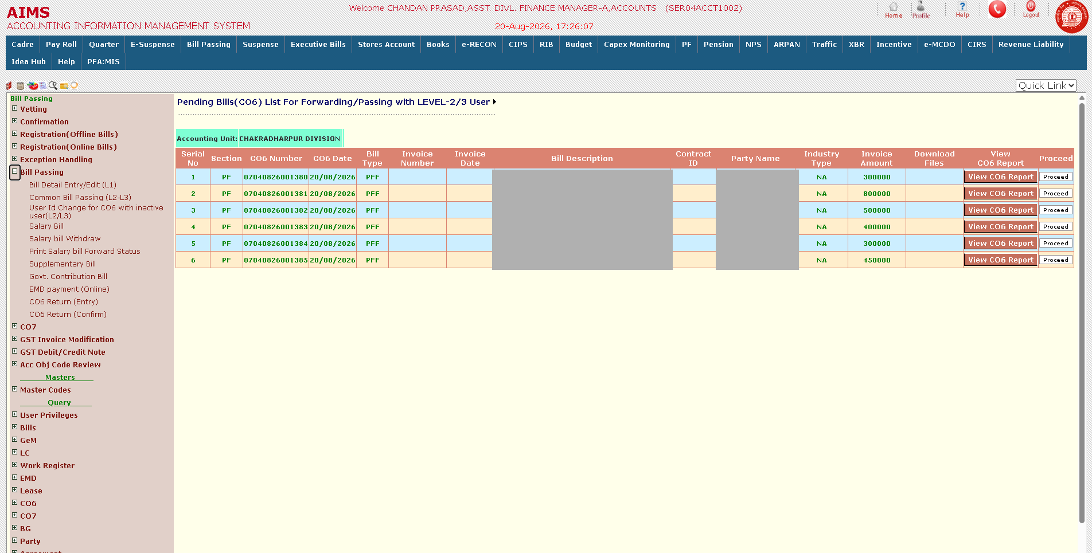
Bill Passing example — pending CO6 bills
Notes:
Six PF final withdrawal bills waiting at Level-2/3. Each already carries its CO6 number, generated at registration. Names and PF numbers are masked. Proceed opens the bill.

Slide 12
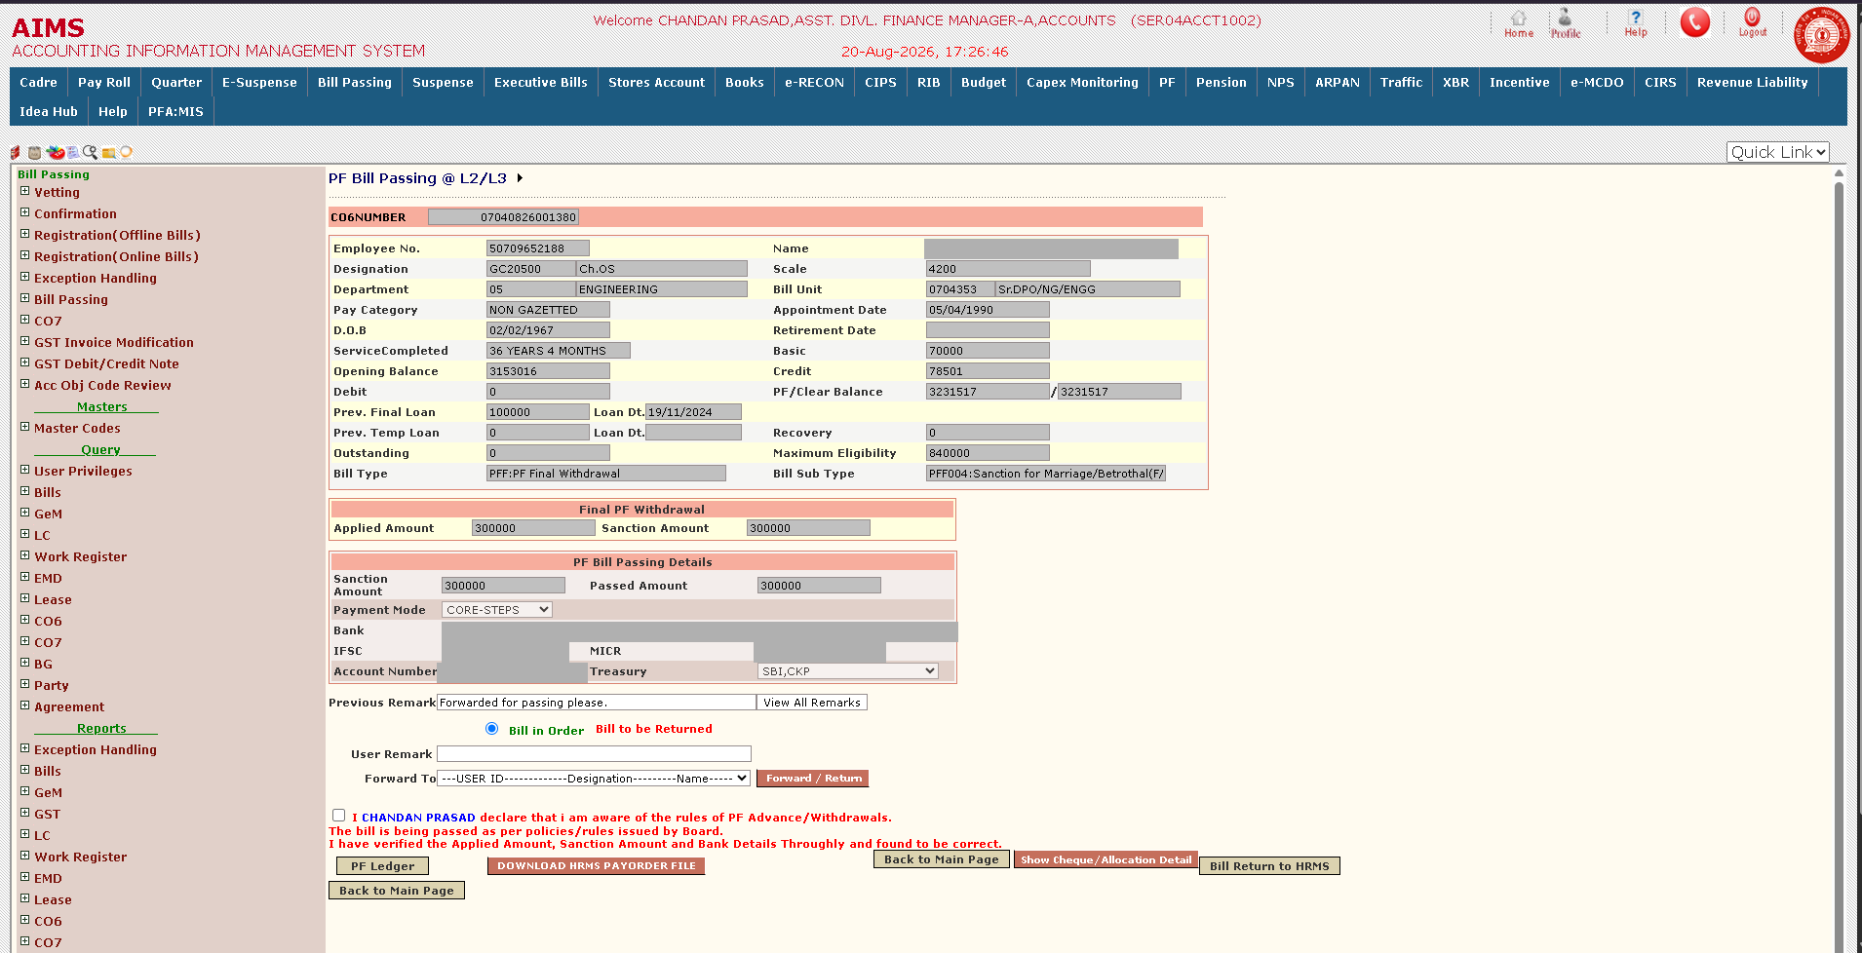
Bill Passing example — PF bill at L2/L3
Notes:
The passing screen. Sanction amount against passed amount, opening balance, credit, debit and clear balance, maximum eligibility. Note the declaration the officer must tick, and the Bill in Order versus Bill to be Returned choice — that is the return path in practice.

Slide 13
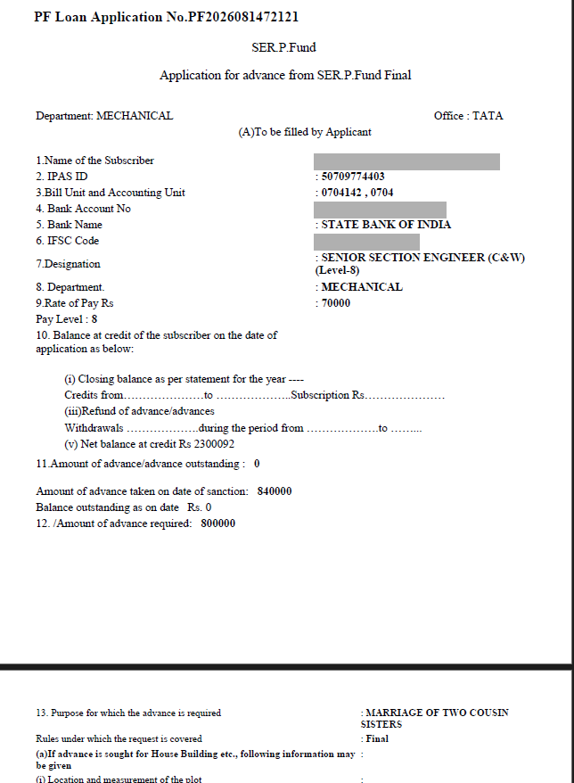
Bill Passing example — the PF advance application
Notes:
The source document behind the bill. Subscriber details, balance at credit, amount of advance taken and outstanding, amount required, and the purpose. The officer checks the bill against this — note the eligibility ceiling and the outstanding position, which is what the ledger screen verifies.

Slide 14
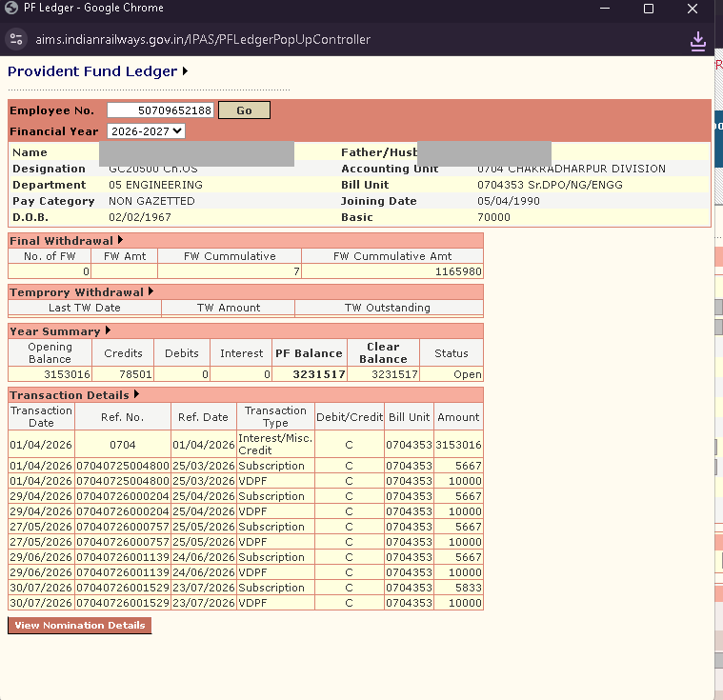
Bill Passing example — PF ledger
Notes:
Opened from the PF Ledger button on the passing screen. The officer can see the subscriber's full transaction history — subscription, VDPF, interest — before passing the withdrawal. This is the check that the balance actually supports the amount claimed.

Slide 15
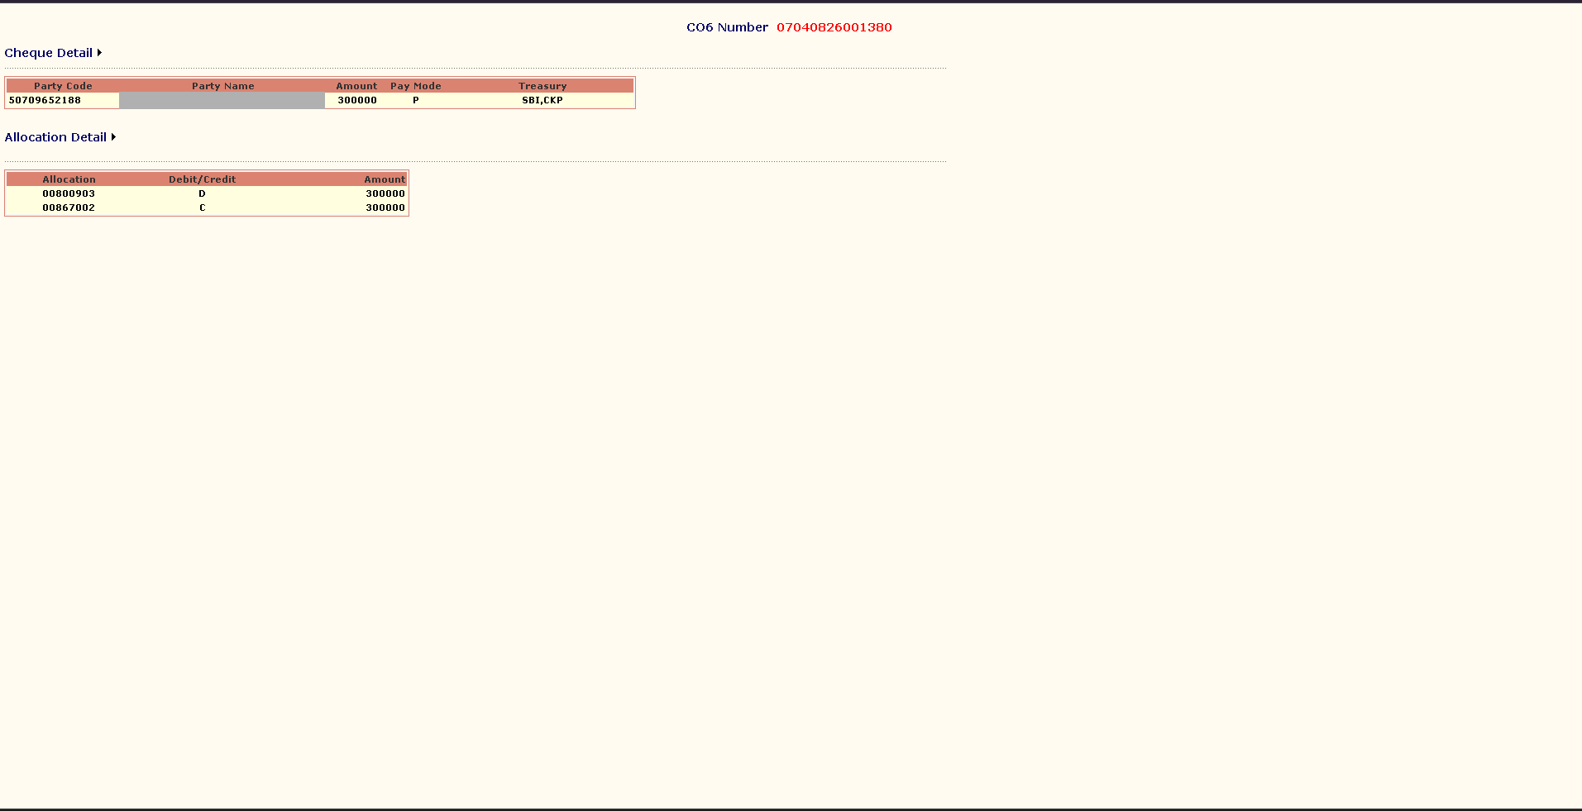
Bill Passing example — cheque and allocation detail
Notes:
The debit and the credit both stand at 300000. This is the balance rule made visible — if these two did not agree, the bill could not be passed. Pay mode and treasury are shown alongside.

Slide 16
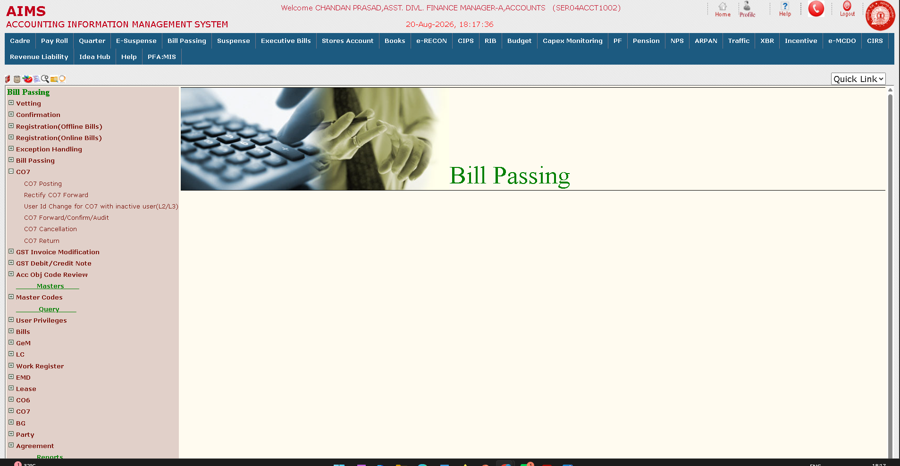
CO7 confirmation — the menu
Notes:
The CO7 branch: Posting groups the passed CO6s, Forward/Confirm/Audit moves and confirms it, Cancellation reverses the whole CO7, Return sends it back. Rectify CO7 Forward handles wrong routing.

Slide 17
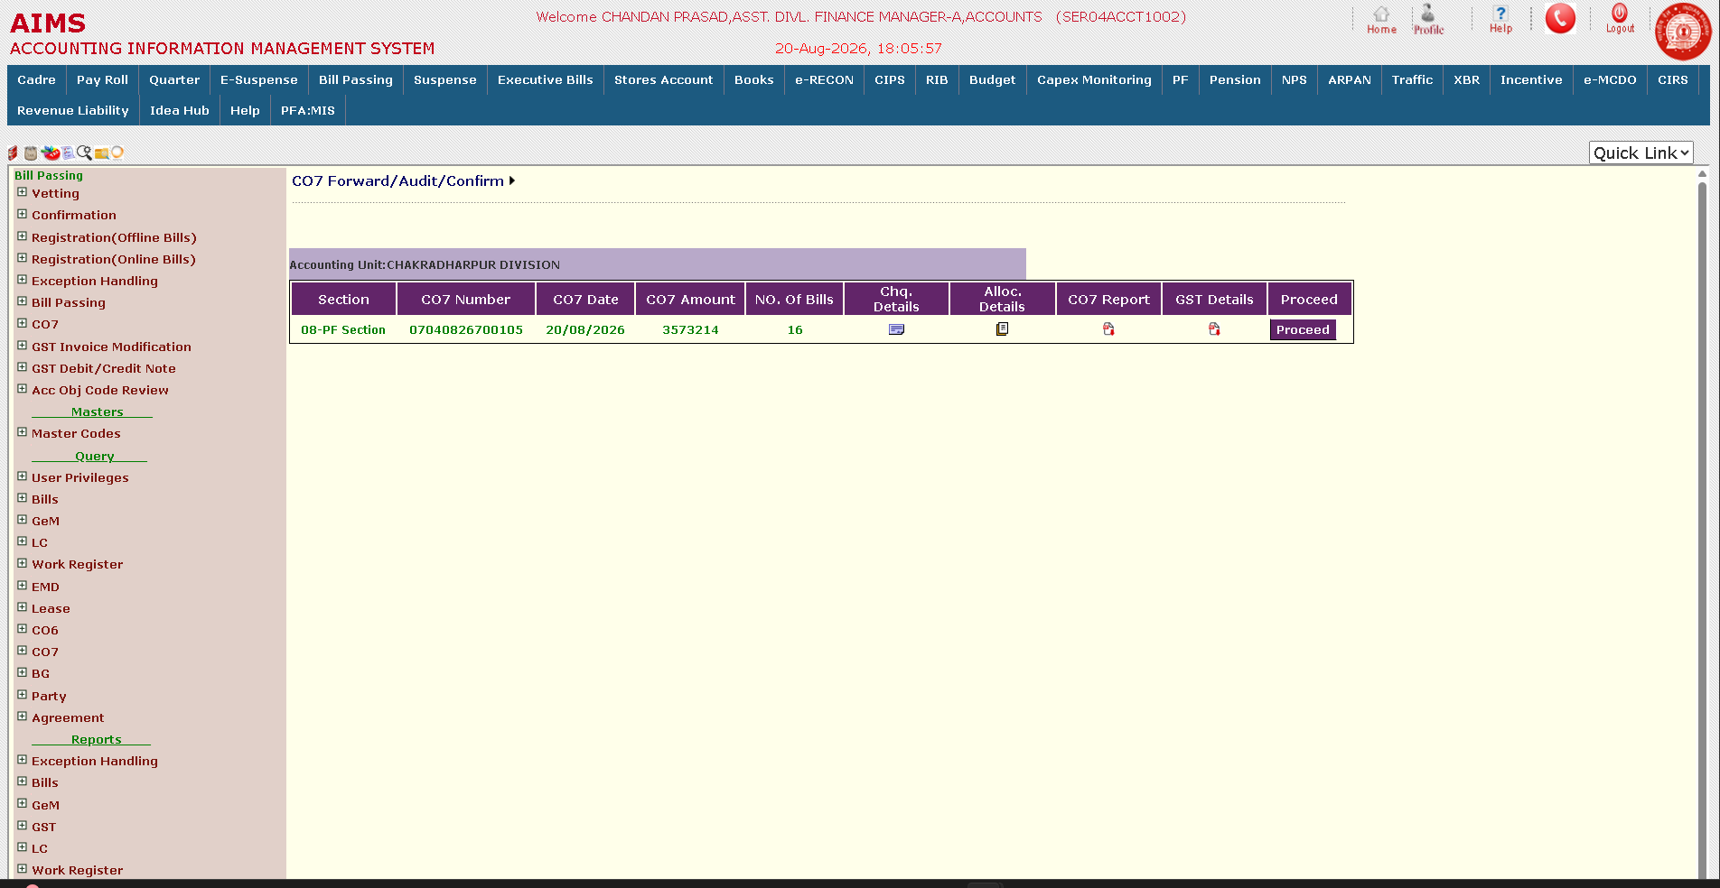
CO7 confirmation — forward, audit, confirm
Notes:
One CO7 for the PF section: sixteen bills totalling 35,73,214. Cheque details, allocation details, the CO7 report and GST details are each openable from here before anything is confirmed.

Slide 18
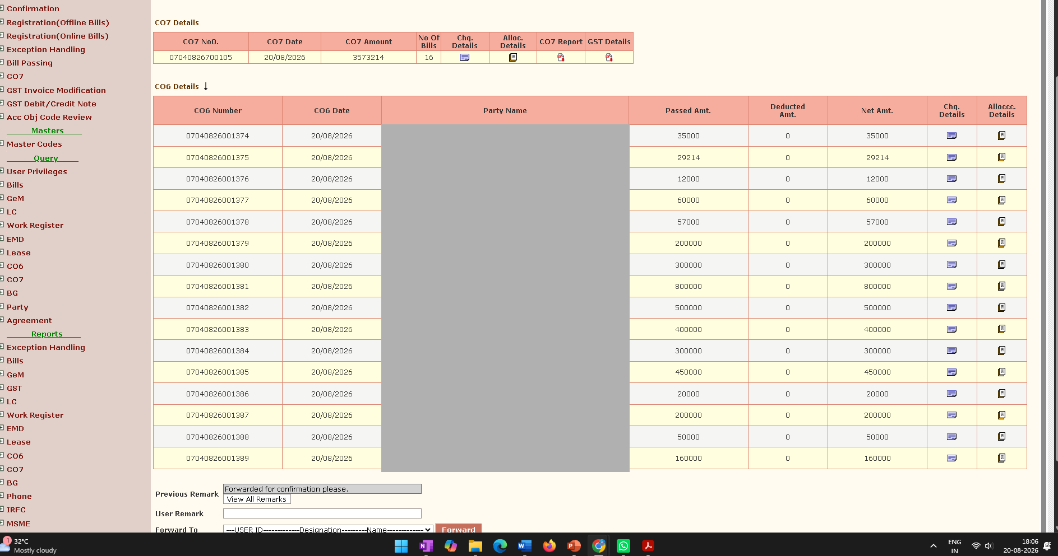
CO7 confirmation — the CO7 and its CO6s
Notes:
The same CO7 opened out into its sixteen constituent CO6s, each with passed, deducted and net amount. This is the grouping the earlier diagram described. Forward sends it on for confirmation.

Slide 19
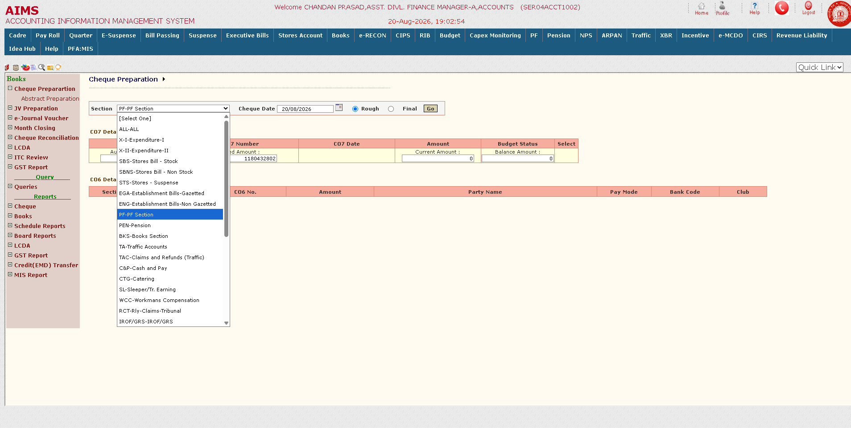
Books — cheque preparation
Notes:
The confirmed CO7 reaches Books. Abstract preparation runs section-wise — the dropdown shows every section that raises bills, from stores and establishment through PF, pension and traffic. Rough lets the abstract be checked before Final commits it.

Slide 20
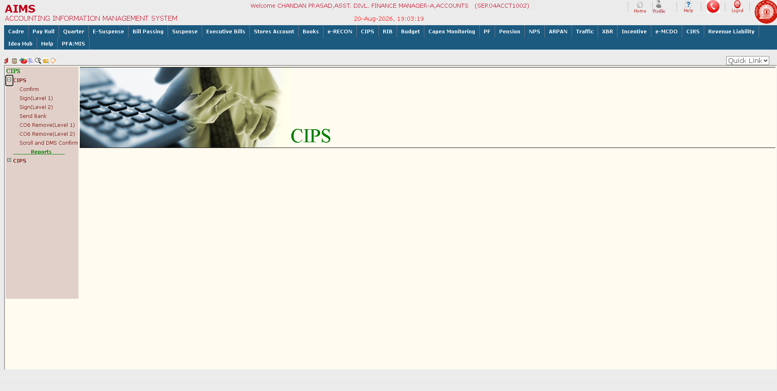
CIPS — the menu
Notes:
From the abstract, payment moves to CIPS: Confirm, then Sign at Level 1 and Level 2, then Send Bank. CO6 Remove exists at both levels, and Scroll and DMS Confirm closes the loop once the bank responds.

Slide 21
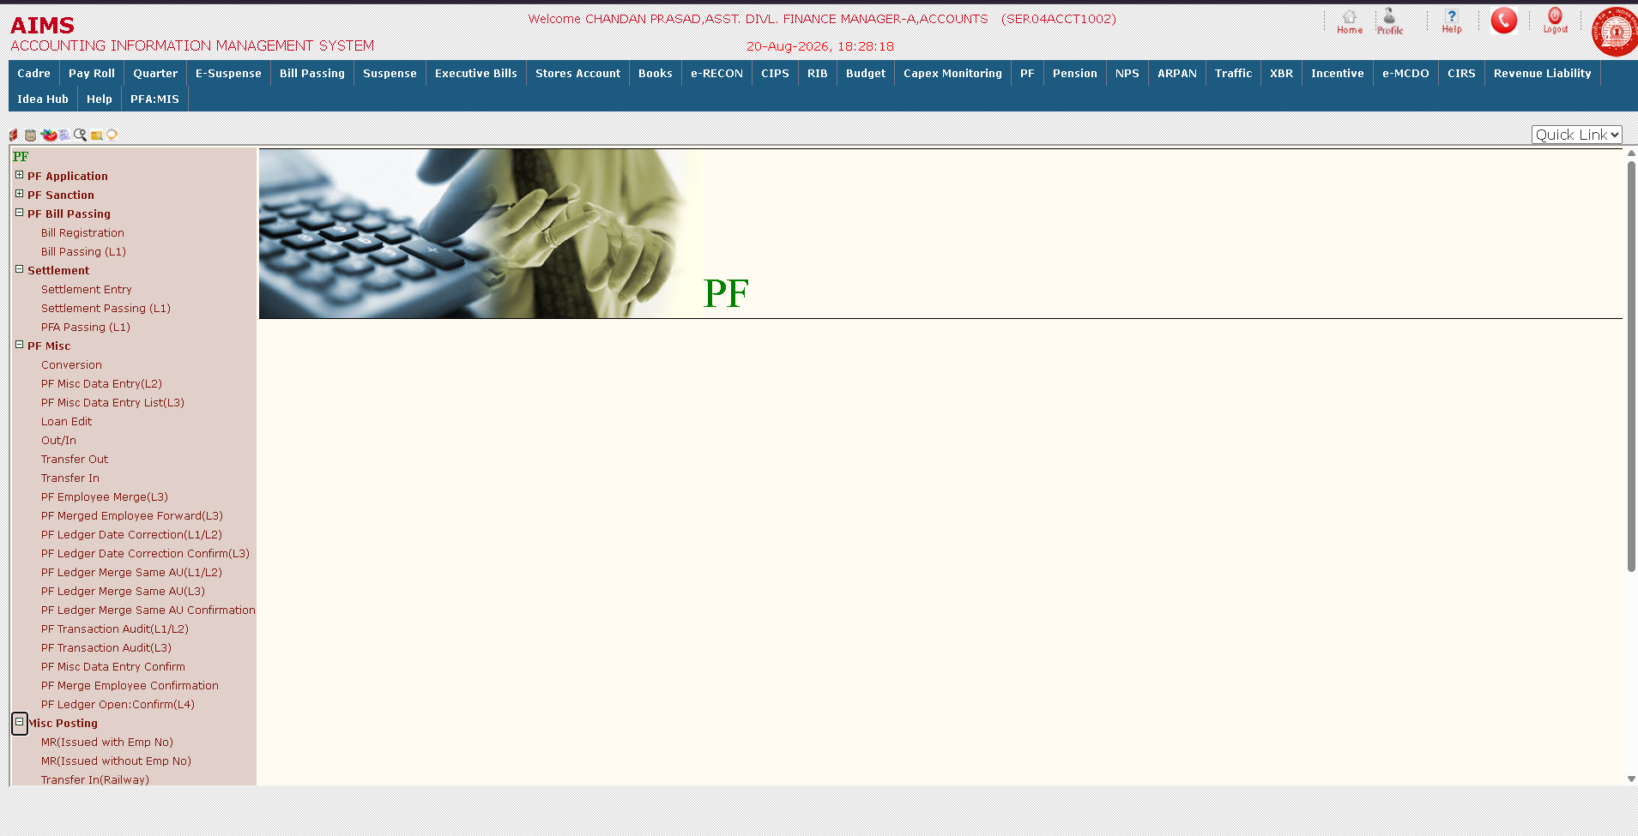
PF — the module
Notes:
The PF module end to end: Application and Sanction at the top, then PF Bill Passing with registration and L1 passing, Settlement on closure, and PF Misc — which carries conversion, loan edit, transfer out and in, ledger date correction, employee merge and the transaction audits.

Slide 22
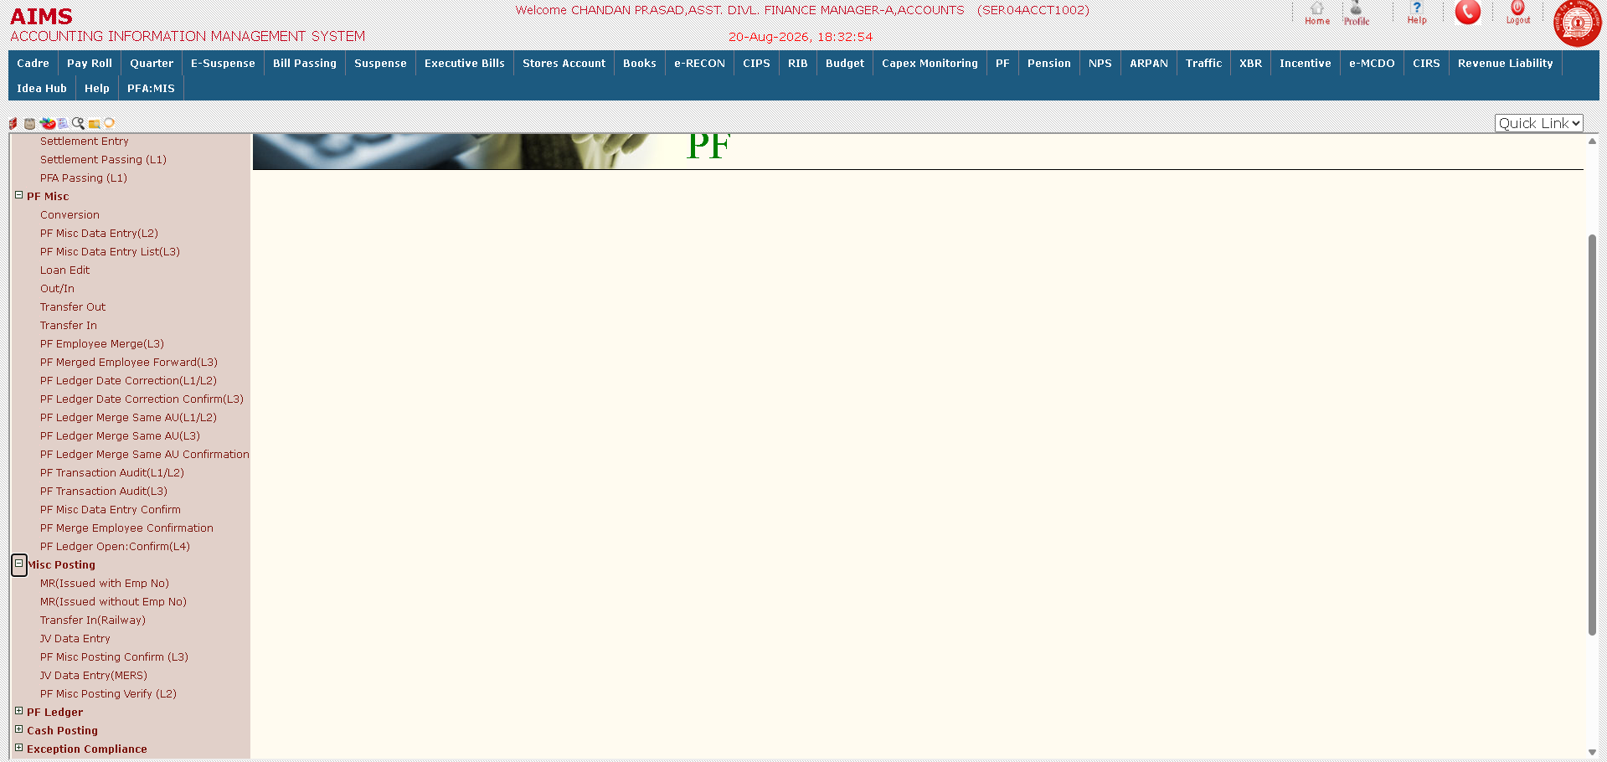
PF — misc posting
Notes:
Misc Posting expanded: MR issued with and without employee number, Transfer In (Railway), JV Data Entry and its MERS variant, and the two-stage control — PF Misc Posting Verify at L2, then Confirm at L3. PF Ledger, Cash Posting and Exception Compliance sit below.

Slide 23
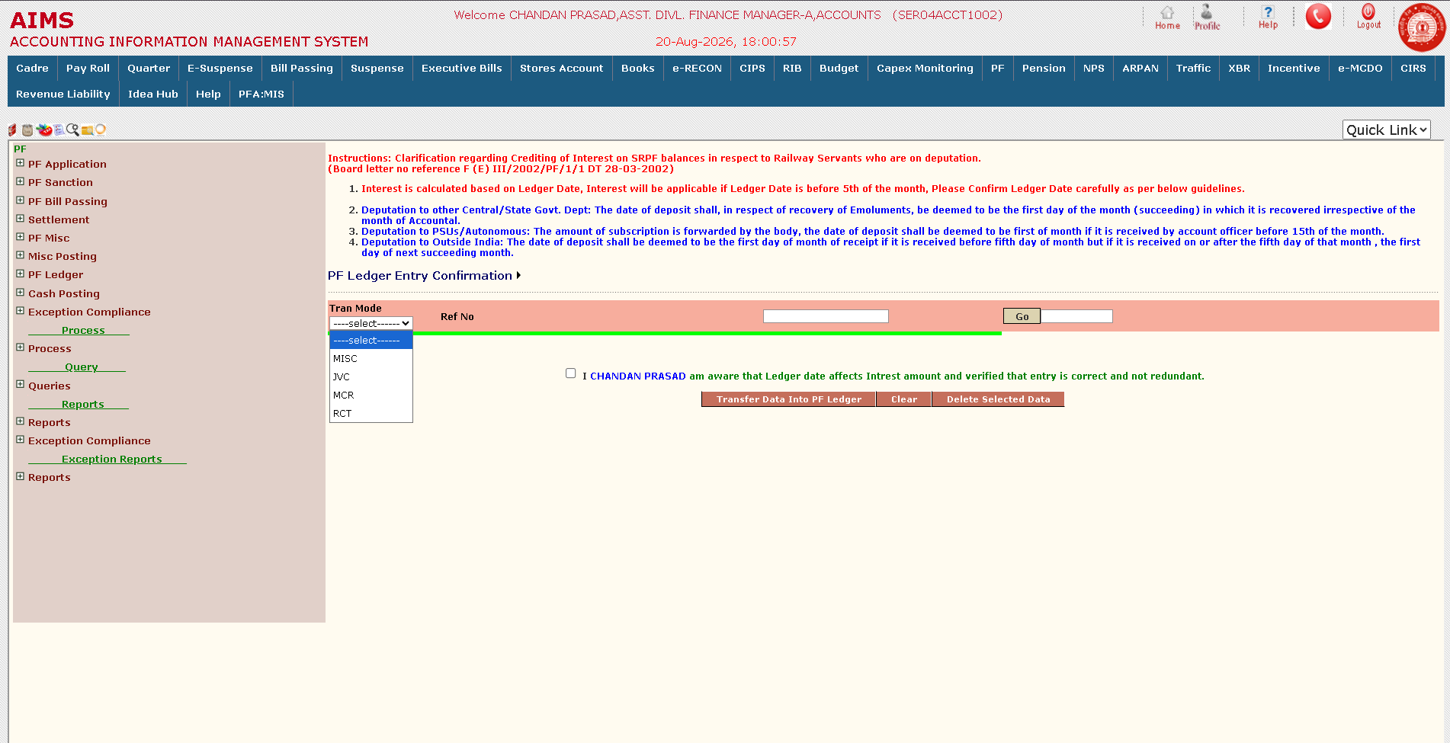
PF ledger — entry confirmation
Notes:
The confirmation screen. Read the Board instruction at the top aloud — interest depends on ledger date, and a date after the 5th of the month costs the subscriber a month's interest. The Tran Mode dropdown selects what is being posted: MISC, JVC, MCR or RCT.

Slide 24
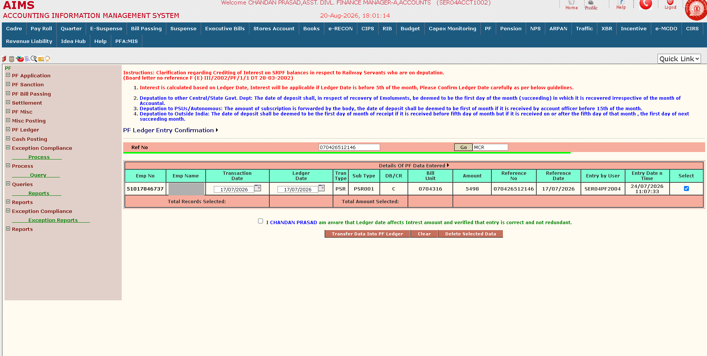
PF ledger — MCR record fetched
Notes:
An MCR reference fetched. Transaction date and ledger date are both editable here, which is exactly why the instruction above matters. Note the entry-by user and timestamp — somebody else keyed this, and a different officer is confirming it.

Slide 25
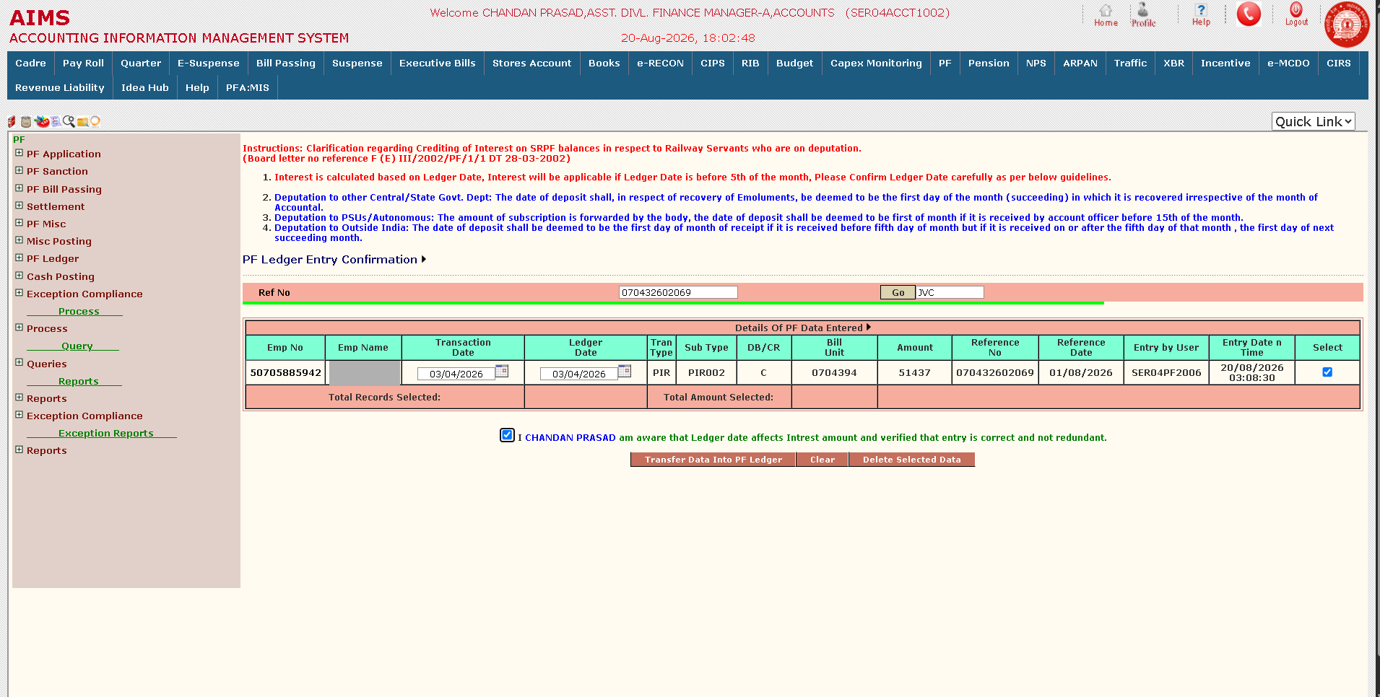
PF ledger — JVC record selected
Notes:
A JVC reference, record selected and the declaration ticked. The officer is certifying that the ledger date is right and the entry is not a duplicate — redundancy being the common failure here.

Slide 26
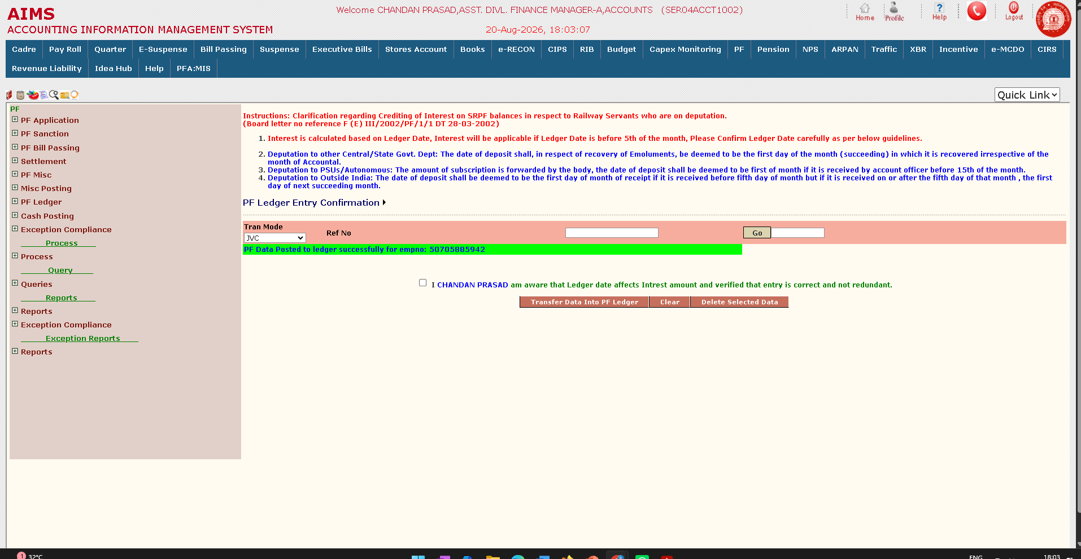
PF ledger — posted
Notes:
Transfer Data Into PF Ledger completes the posting and the system confirms against the employee number. Only now does the amount appear in the subscriber's ledger.

Slide 27
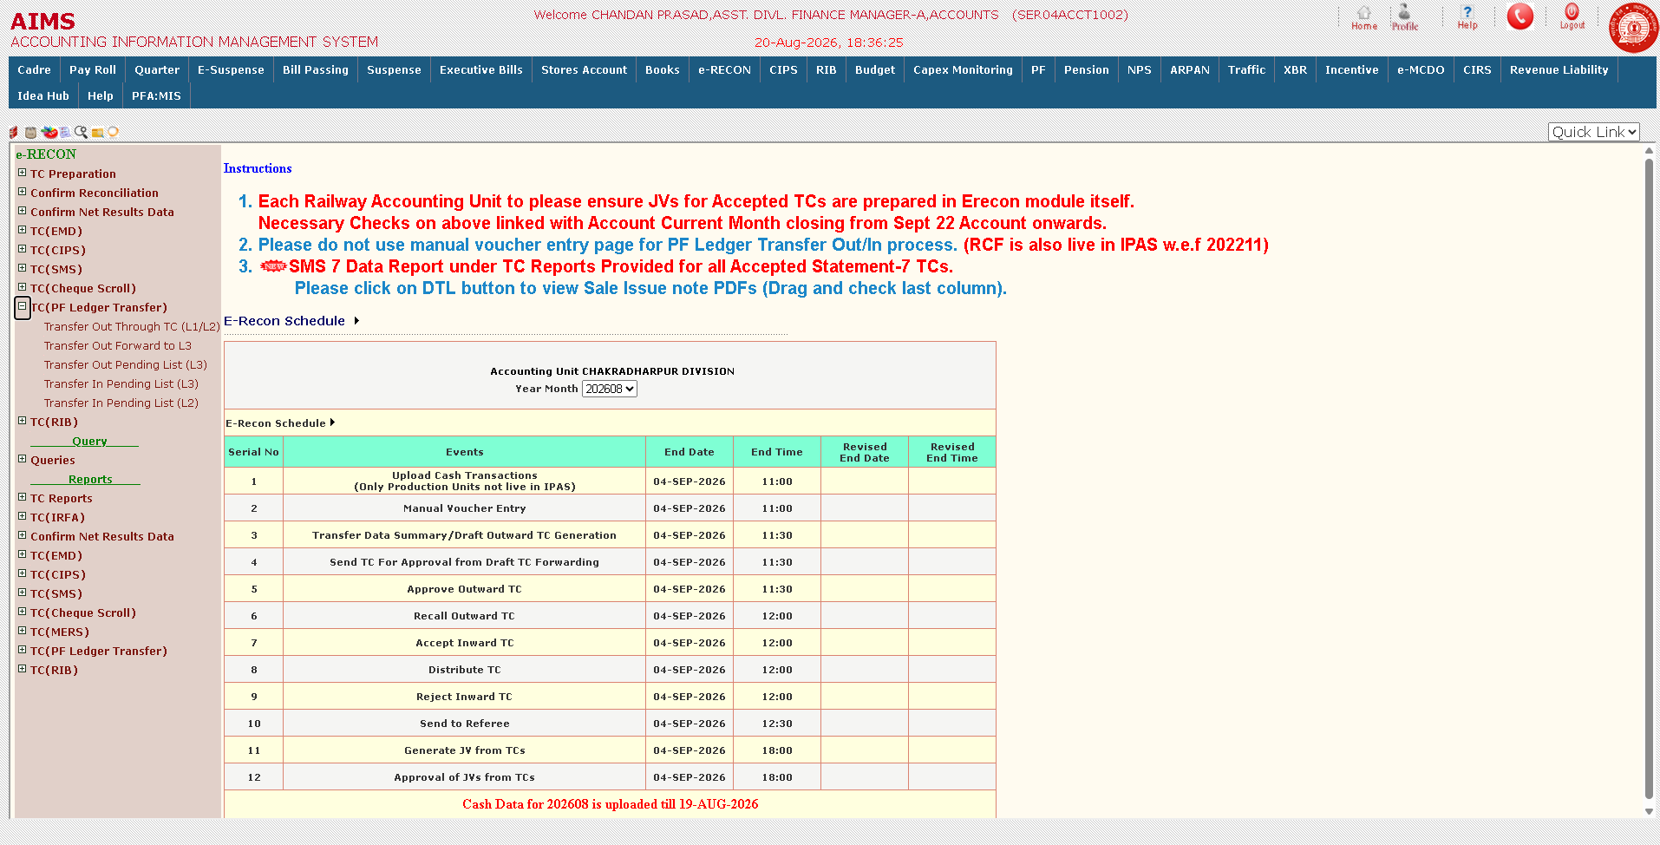
PF transfer — out through TC
Notes:
When an employee moves between accounting units the PF balance moves with them, and it moves through e-RECON as a transfer certificate. Transfer Out through TC at L1/L2, forward to L3, and pending lists on both sides. Note instruction 2 on screen: manual voucher entry must not be used for this.

Slide 28
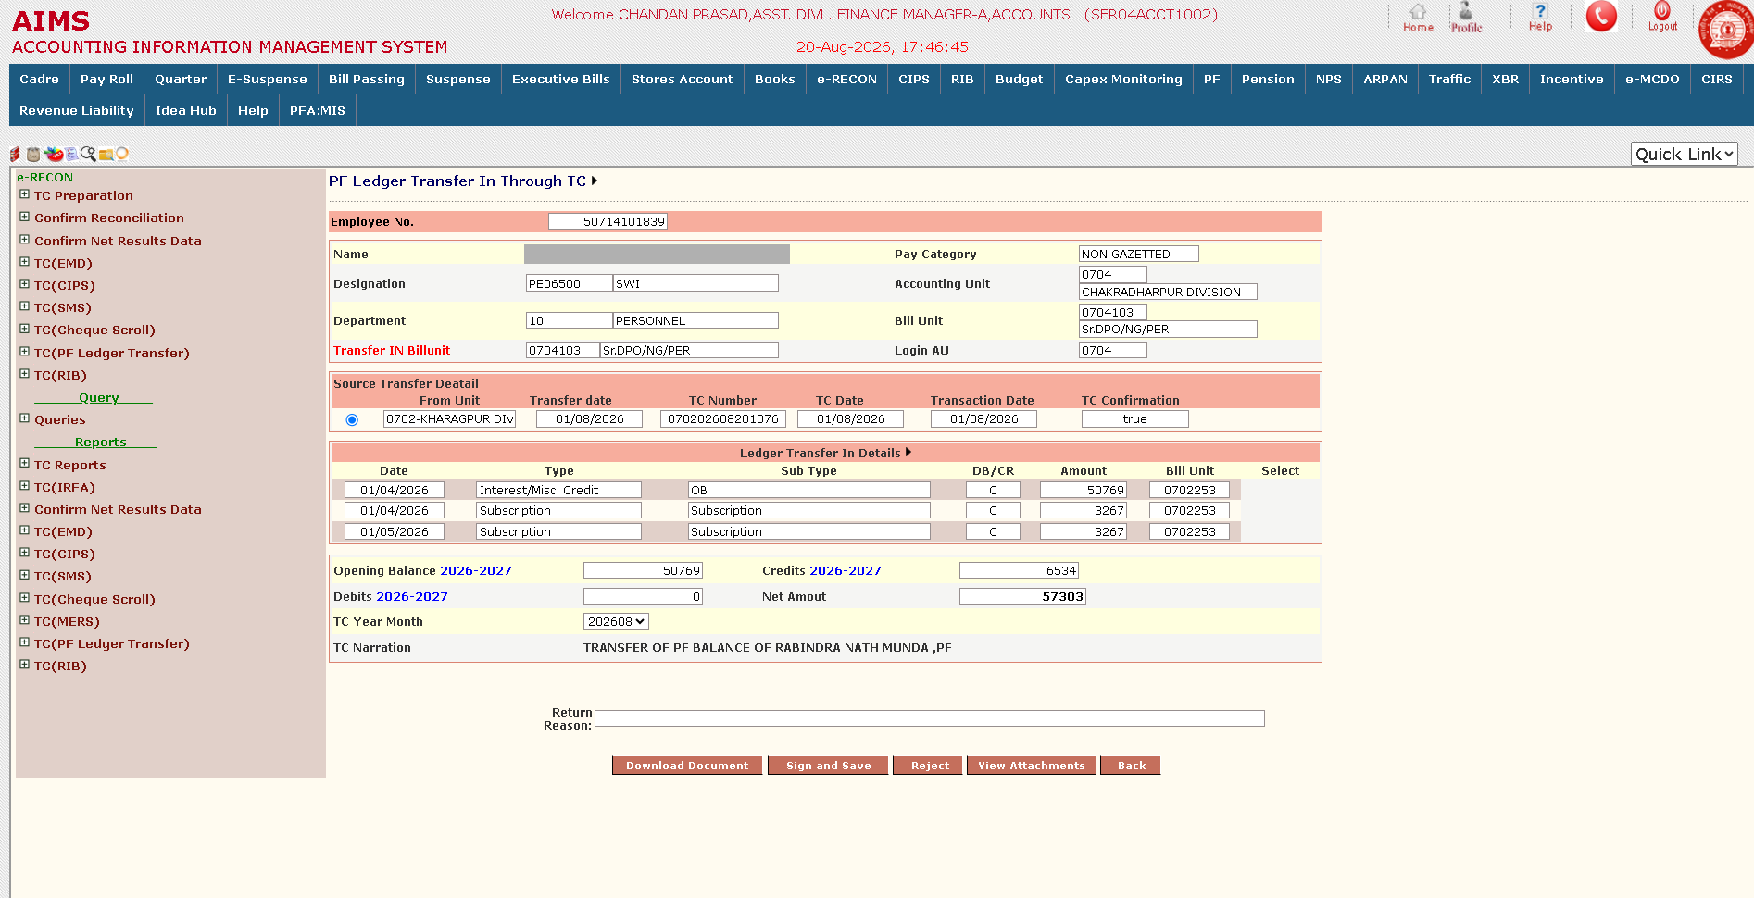
PF transfer — in through TC
Notes:
The receiving end. Source unit, TC number and date are shown, then the ledger detail being brought in — opening balance and each subscription line — with the resulting balance for the new unit. Sign and Save accepts it; Reject sends it back with a reason.

Slide 29
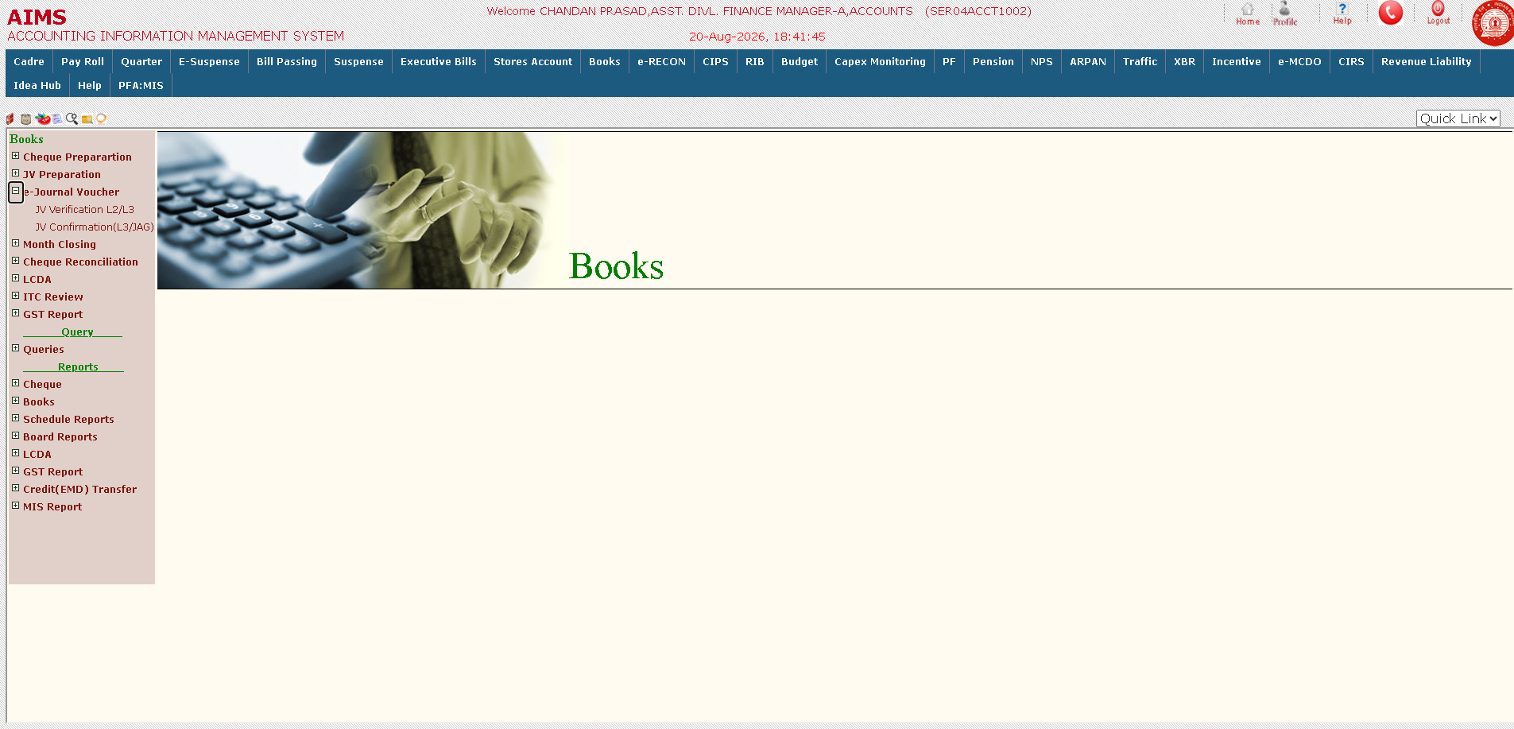
PF ledger adjustment — e-Journal Voucher
Notes:
Where a PF ledger correction needs a journal voucher, it runs through Books. The e-Journal Voucher branch carries JV Verification at L2/L3 and JV Confirmation at L3/JAG — the same two-stage control as everywhere else.

Slide 30
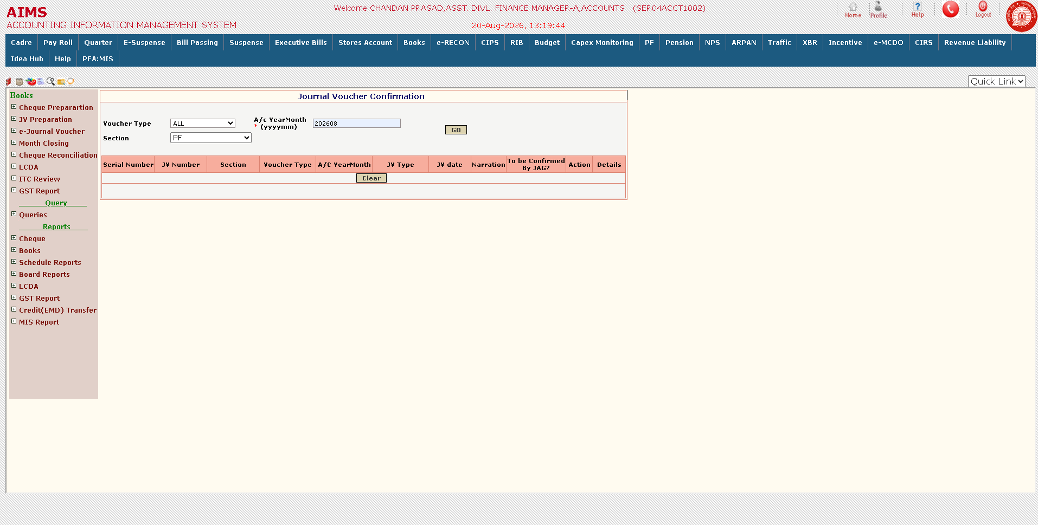
PF ledger adjustment — JV confirmation
Notes:
The confirmation filter — voucher type, accounting year-month and section. Nothing pending here, which is what a clean month looks like.

Slide 31
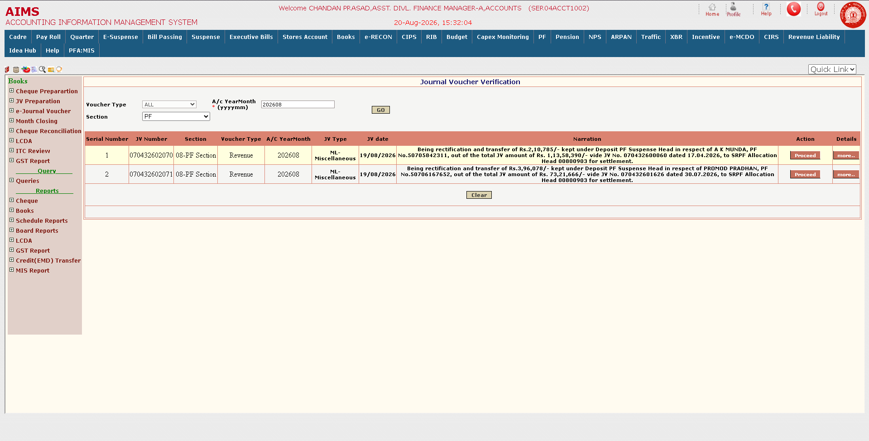
PF ledger adjustment — JV verification
Notes:
Two PF-section JVs awaiting verification. Read a narration aloud: an amount sitting in Deposit PF Suspense is being rectified and transferred to the SRPF allocation head for settlement, against the original JV. That sentence is the whole purpose of the adjustment.

Slide 32
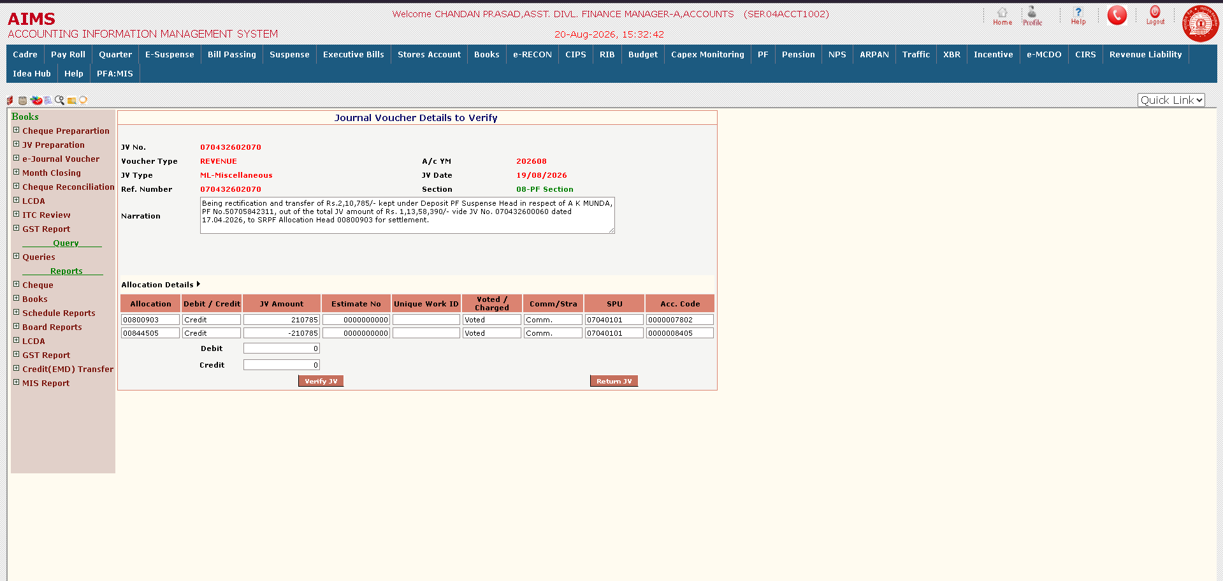
PF ledger adjustment — verifying the JV
Notes:
The same voucher as the verifying officer sees it. The narration states the amount, the subscriber, the original JV it came from and the head it is going to. Note the allocation and its negative contra — the two net to zero, the balance rule appearing again at the far end of the process. Verify JV accepts it; Return JV sends it back.

Slide 33
CIPS — Centralised Integrated Payment Solution
Signatory authorisation
Confirm abstract
Sign — Level 1
Signatories are registered by the accounting unit's Administrator against the same digital token held for tender opening. The public key is pushed to the bank daily, and signing rights activate only once the bank acknowledges it.
Books confirms the abstract, fixing the set of CO6s it carries before any signature is applied.
The first signatory signs the mandate and text file and forwards it.
Sign — Level 2
Send to bank
CO6 removal
The second signatory adds the second signature. Payments above the threshold require both, mirroring the two-signature rule for cheques above ₹10 lakh.
The zipped, dual-signed file is transmitted to State Bank of India through direct system-to-system integration, and beneficiary accounts are credited.
A CO6 can be withdrawn from the abstract, but only before despatch and only by a valid signatory using the same token. Removal is itself a two-level action.
Notes:
This is where their name will go on the payment. Within a few years they will personally be a CIPS signatory, and this is the last human check before public money leaves the Railway. Stress that the token is theirs and must never be shared — the Northeast Frontier fraud came from shared credentials. Scroll and DMS confirmation closes the payment against its supporting papers, and reconciliation runs off the scroll the bank returns, with an abstract-wise summary and a payment-wise detail report.

Slide 34
Cadre — the employee master record
Bio-data
Verification and confirmation
Withdrawal and activation
Creation and maintenance of the employee master record, with Family, Qualification and Nomination details. Mobile number, e-mail and Aadhaar each carry their own verification screen.
A new record is entered, then separately verified and confirmed before it goes live. Entry and confirmation are deliberately different people — no employee reaches payroll on one user's action.
A record may be withdrawn before confirmation. Activation is separately permitted and then performed.
Rectification
Duplicate control
Cadre, 7th CPC and pension scheme
Changes to a live record run through their own forward-and-return chain — for serving and non-serving employees and for bank details — with a standing list of forwarded and returned cases.
Duplicate bio-data flagging catches the same person held under more than one employee number.
Book of Sanction and the Cadre Report; pay commission revision screens; and the record of movement from NPS or UPS to the PF scheme.
Notes:
The teaching point is the separation of entry and confirmation. Ask them why the system insists on two people: because a fictitious employee entered and confirmed by one person is a salary paid every month to nobody. PAN, PRAN and Aadhaar accuracy here determines everything downstream, and every change is logged with user, timestamp and IP address.

Slide 35
PFA:MIS — exception reports
Duplicate account numbers
Repeated arrears
Threshold breaches
Two or more employees receiving payment into the same bank account in the same month.
Arrear paid more than twice in a year against a single allowance.
Any allowance paid above the defined threshold amount.
Duplicate identifiers
Invalid data
Scheme mismatch
The same PAN, PRAN, Aadhaar or bank account number appearing against more than one employee.
Impossible or dummy dates of birth and appointment, grade pay not matching pay band, and mandatory fields left unfilled.
An NPS employee still carrying a PF deduction, or a PF employee with no PF deduction at all.
Notes:
The most consequential slide for their working life. These reports are how a PFA forms a view of an officer before meeting them. The system already finds these — nobody has to go looking. An unexplained exception is a question you will be asked. The CAG found data sanitisation the weakest area in IPAS; this screen is the remedy and it is already built. An administrator can also write a direct SQL query against a replicated reporting database for anything the standard reports miss.

Slide 36
e-RECON — inter-unit settlement
TC preparation
Approval and recall
Inward TC
Transfer data is summarised into a draft outward transfer certificate for the receiving unit.
The draft is forwarded for approval and approved; an outward TC can be recalled before the other unit accepts it.
The receiving unit accepts, rejects or distributes the certificate. A disputed certificate is sent to a referee for settlement.
Journal vouchers
Transfer certificate types
Schedule and closure
JVs are generated from accepted TCs and then approved, gated by value. They must be raised within e-RECON itself — manual voucher entry is not to be used for PF ledger transfer.
Separate streams handle EMD, CIPS, cheque scroll, PF ledger transfer, RIB, MERS, SMS and IRFA transactions, each on the same approval path.
Every event carries a dated and timed cut-off for the accounting month, closed out by confirmation of reconciliation and of net results data.
Notes:
Before this module, inter-unit settlement was a manual correspondence process with chronic delay. The point worth making is the schedule: the month closes on a timetable, and a missed cut-off pushes settlement into the next month. This is also the route by which Headquarter passes IREPS EMD/TDC credit down to divisions.

Slide 37
Thank you
Notes:
Leave this up during questions. If asked something you do not know, say so and offer to find out — CRIS documentation and the nodal railway are the sources. The Helpdesk module logs every issue and the Sr. DFM is the first escalation.

